Slide 1
University of Benghazi Ranking & Quality : Steps Forward… A Brief Overview about the Current Efforts towards Higher Ranking and Quality Presented by: Dr. Ageila Ali Elabbar Head of the Committee of Promoting the UoB International Ranking 6th of June 2014: London UK

Slide 2
Steps we did since January 2014
Re-structured a Complete UOB Website with 344 Sub-Domains, and apps

Slide 3
University knowledge Base
2. Designing and activating the UOB Knowledge Base ;which will include all publications and research participations for the university staff.

Slide 4
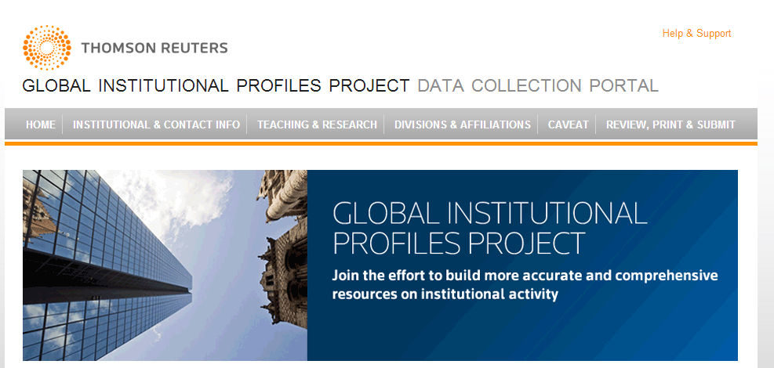
Linking the UOB with Thomson Reuters, and other Research Organizations

Slide 5
We have achieved so far ….
Registering 2300 out of 3000 staff CVs within their 23 faculties; which also( the faculties) include course descriptions and study Plans.
Starting the UOB electronic library; which includes over 1000000 books and videos.
We are now the first university in Libya in terms of web- spread according to Alexa and SEO web analytical organizations.
Activating online registration, online services such as ; portals , SIS and staff-database.
Preparing for this year ranking according to the Times international Ranking (Oct2014), as well as web matrices ( August 2014)..

Slide 6
Coming Steps
Continuing Professional Development (CPD) for teachers and TAs.
Online Courses and models which enable students to work ftf and online .
Wider students and staff online links with international universities and research organizations.
Implementing technology ; such as blended learning and distance learning.
Funding researchers, lab projects , funding conferences, and workshops.
exchange programs for students, TAs and researchers..

Slide 7
Thanks

